Slide 1


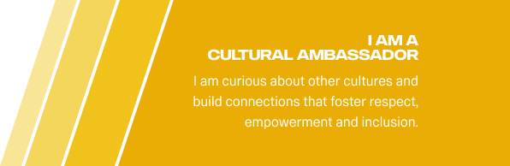


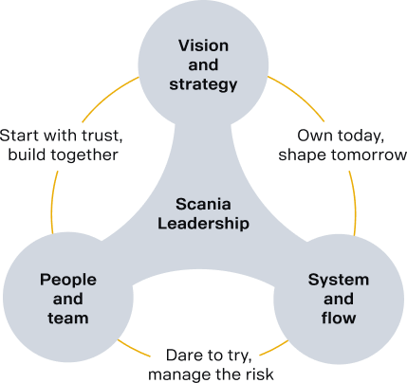

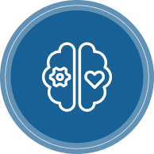

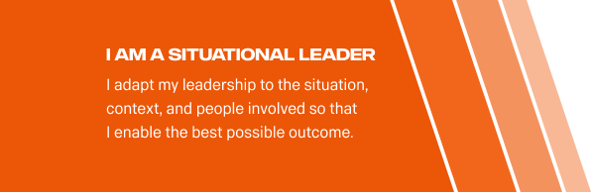


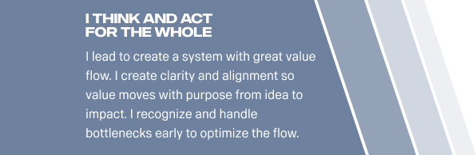

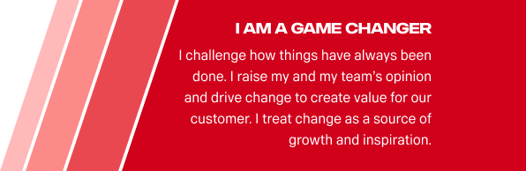


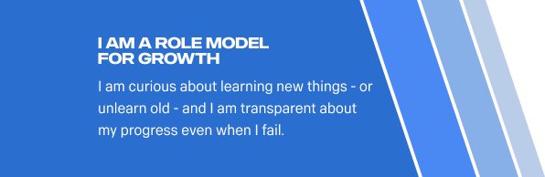

Slide 2

I Align direction via WHY & WHAT
I Align direction via WHY & WHAT
Attitude description:
I clarify the purpose and direction. I empower and trust the team members to lead the HOW with aligned autonomy
Team Behaviours:
We clearly and transparently communicate intent and outcomes. We make direction visible, tangible, and co-owned by the team.
Organizational Result:
People are more confident and proactive in their decision-making. Teams feel empowered.
Teams align faster, collaborate better, and focus on outcomes instead of outputs.
Leadership is distributed — everyone feels responsible for achieving impact.
🧰 Tools:
Why/What/How Canvas, Outcome Framing, OKR Mapping, Intent Briefs, Delegation Boards, Delegation Poker

Slide 3
I am a situational leader
I Align direction via WHY & WHAT
Attitude description:
I adapt my leadership to the situation, context, and people involved so that I support the best possible outcome.
Team Behaviours:
We adjust how we lead based on team maturity and individual needs. We flex between guiding, coaching, or stepping back based on what will create progress. We interact face to face as much as possible
Organizational Result:
We respond faster and more effectively to changing realities. Teams feel understood, supported, and trusted. We create balance between structure and freedom and deliver stronger customer value through adaptability. Less micro-management, more ownership.
🧰 Tools:
Situational Leadership Matrix, Team Maturity Radar, “Support vs Autonomy” Check-ins

Slide 4

I Think and Act for the whole
I Align direction via WHY & WHAT
Attitude description:
I Lead to create a system with great value flow. I create clarity and alignment so value moves with purpose from idea to impact. I recognize and handle bottlenecks early to optimize the flow.
Team Behaviours:
We make our end-to-end value flow visible. We align priorities with real capacity.We limit work in progress to protect focus. We surface bottlenecks early and address root causes.We balance ambition with capacity, protecting both performance and people.
Organizational Result:
Clear direction and focused execution. Faster, more predictable value delivery.
Sustainable pace without burnout. Stronger cross-functional collaboration.
An adaptive system that learns and improves over time.
🧰 Tools:
👉 Value Stream Mapping, Portfolio / Team Kanban with WIP Limit, Flow Metrics , Structured Problem Solving

Slide 5
I am a role model for growth
I Align direction via WHY & WHAT
Attitude description:
I am curious about learning new things - or unlearn old — and I am transparent about my progress even when I fail.
Team Behaviours:
We share our own development goals transparently. We ask for feedback regularly. We talk openly about what we´re unlearning and we encourage retros for learning cycles
Organizational Result:
Growth becomes part of the team culture. People feel safe to make mistakes. Continuous improvement feels real, not theoretical. Retros is part of the feedback loops.
🧰 Tools:
👉 Feedback Canvas, Retro, Learning Logs, “What I’m Unlearning” Team Wall

Slide 6
I am a game changer
I Align direction via WHY & WHAT
Attitude description:
I challenge how things have always been done. I raise my and my teams opinion and drive change to create value for our customer. I treat change as a source of growth and inspiration.
Team Behaviours:
We question old assumptions, run experiments, and navigate uncertainty with care. We surface and remove blockers early, encourage risk-taking and learning. We work to improve the system and remove impediments even when its hard.
Organizational Result:
We innovate faster. Change feels energizing instead of threatening. Teams adapt smoothly, bounce back from disruption, and grow stronger and smarter with every shift.
🧰 Tools:
Experiment Canvas, Change Champion Circles, Retros with “break-the-routine” prompts, Stake holder management, Story Telling

Slide 7
I lead with empathy and intent
I Align direction via WHY & WHAT
Attitude description:
I lead with understanding — and act with clarity, transparency and care.
Team Behaviours:
I listen to what’s said and unsaid. I share my intent before making decisions. I prioritize human connection alongside goals. I show up authentic at all times.
Organizational Result:
Less friction and more trust and authenticity in communication and relations. Greater psychological safety. Team members feel respected and aligned.
🧰 Tools:
Ladder of Inference, Empathy Interviews, Intent Clarity Framework (“My intent is…”) X and Y leadership

Slide 8
I Cultivate Psychological Safety
I Align direction via WHY & WHAT
Attitude description:
I create a safe place for teams to speak openly, to risk, and to grow.
Team Behaviours:
We invite every voice into the conversation. We celebrate curiosity, even when wrong. We praise risk-taking and effort, not just output.
Organizational Result:
More diverse ideas surface. Problems are addressed earlier. Team morale and collaboration improve between people, teams and cultures.
🧰 Tools:
Psychological Safety Pulse Survey, “Red Flag Round” in dailies, Retros with “What I didn’t say” rounds

Slide 9

I am a Cultural Ambassador
I Align direction via WHY & WHAT
Attitude description:
I am curious about other cultures and build connections that foster respect, empowerment, and inclusion
Team Behaviours:
We stay open and curious to understand different perspectives. We adapt how we connect so everyone feels respected and valued. We build bridges across cultures and teams to foster inclusion and shared success.
Organizational Result:
Culture by Design - Our culture becomes intentional, not accidental.
People feel they belong, can contribute fully, and trust the environment.
Teams thrive across boundaries, backgrounds, and differences.
🧰 Tools:
Culture Toolbox, Culture Connect Game Cultural Check-ins, Inclusion Nudges, Team Agreements, Retros with “culture lens,” Scania Core Values cards

